Slide 1
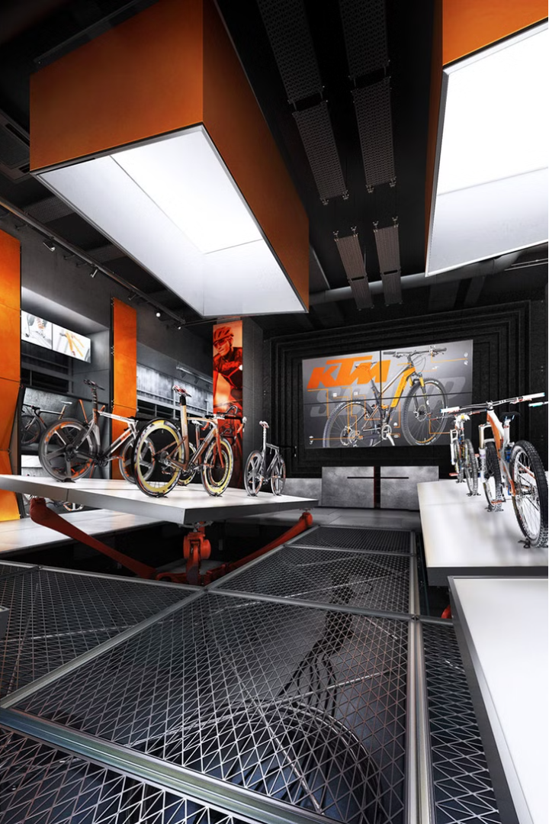


Welcome to Ride Easy
Discover your dream bike at our state-of-the-art showroom, where quality and innovation converge to elevate your riding experience.
by pratap patil

Slide 2
Our Bike Showroom
Expansive Selection
Interactive Displays
Expert Assistance
Browse our vast collection of the latest bike models, from sleek city commuters to rugged mountain bikes.
Interact with interactive displays to explore the features and specifications of each bike in detail.
Our knowledgeable staff is on hand to provide personalized guidance and help you find the perfect bike.

Slide 3



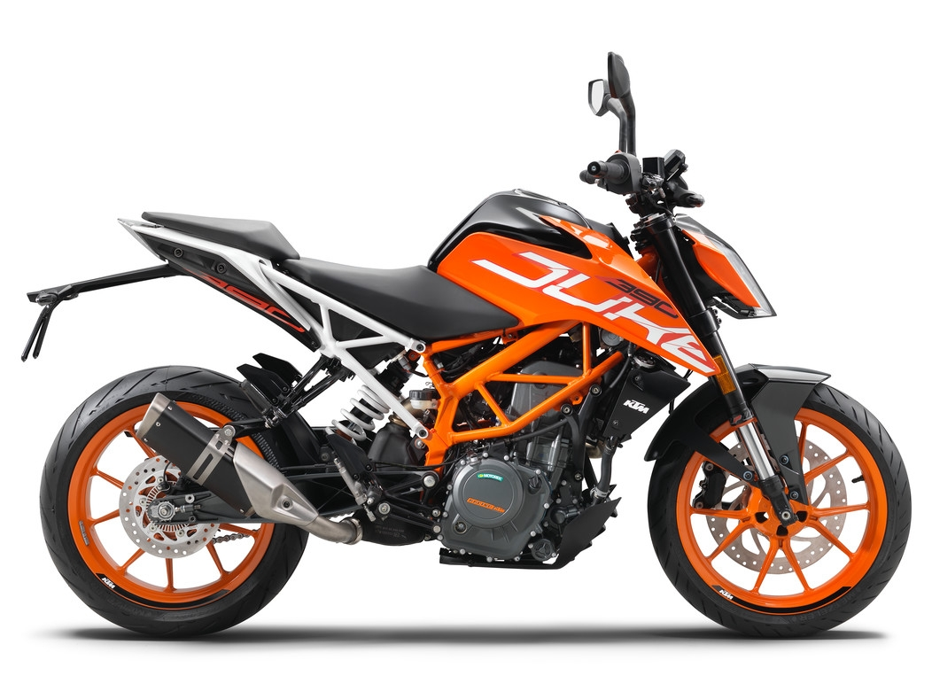
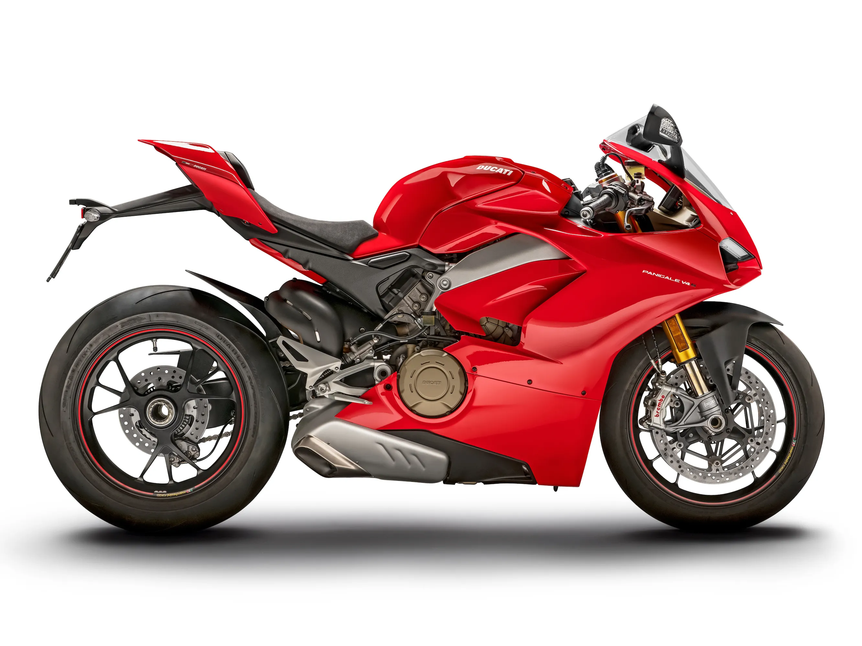
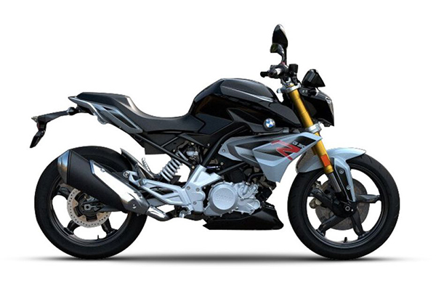
Featured Bikes
Rugged Mountain Bike
Sleek Road Bike
Cutting-Edge Electric Bike
Experience the thrill of speed and efficiency with our aerodynamic road bike, perfect for the open road.
Conquer the trails with our top-of-the-line mountain bike, designed for maximum performance and durability.
Explore the city with ease using our state-of-the-art electric bike, offering a smooth and eco-friendly ride.

Slide 4
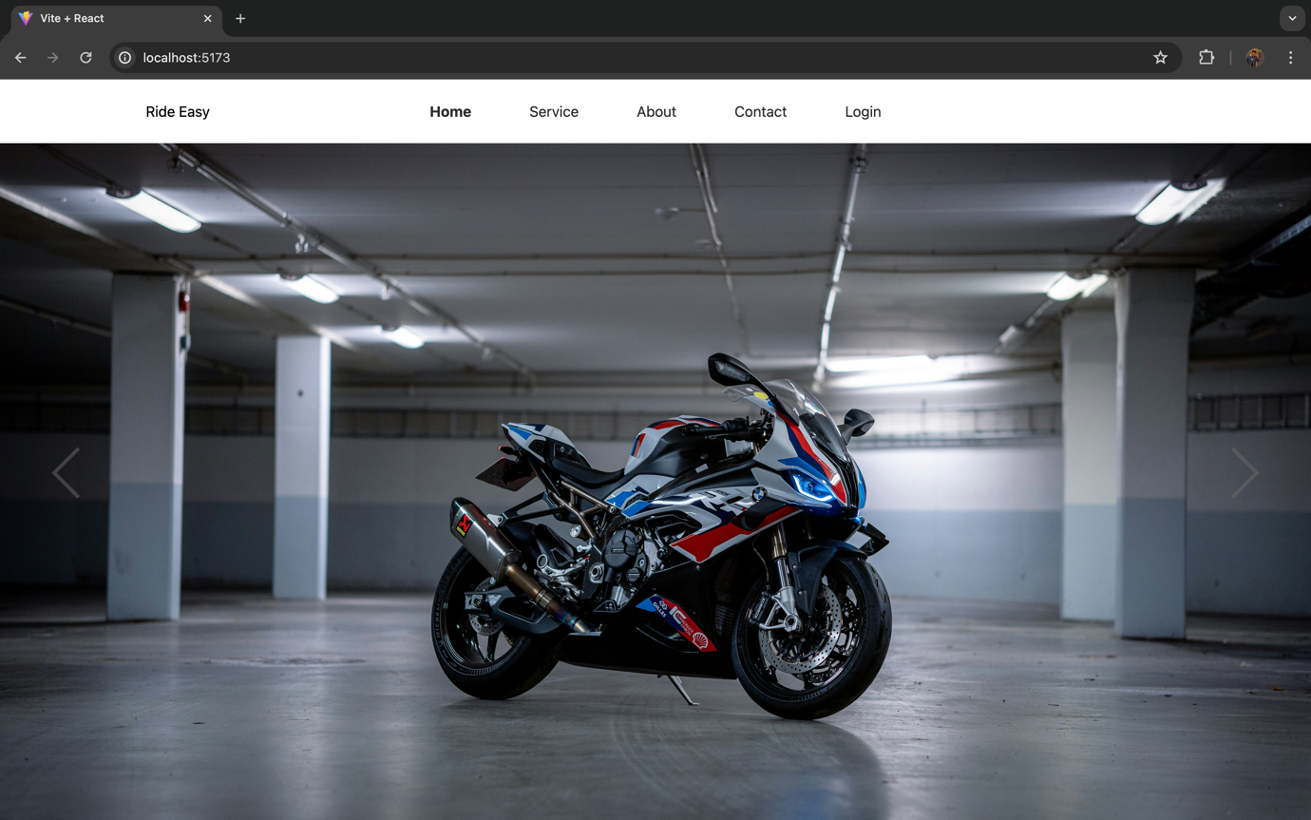
Design

Slide 5
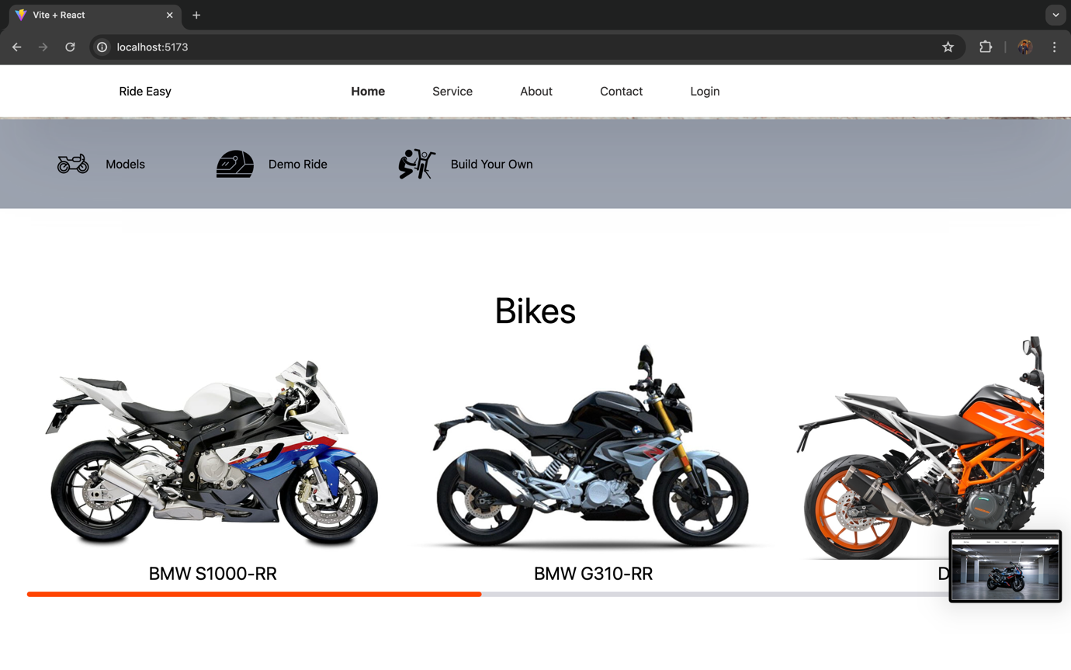

Slide 6
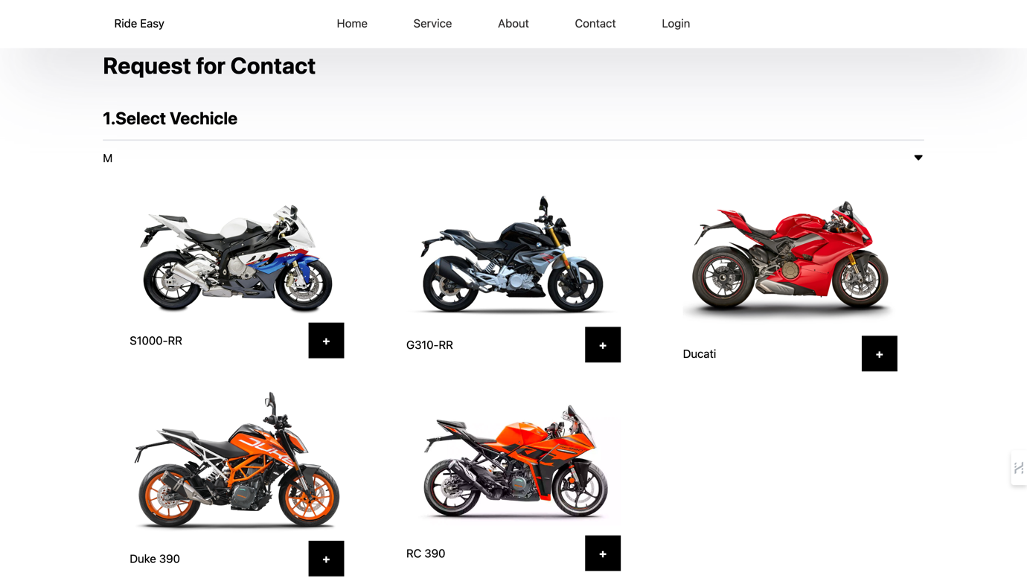

Slide 7


Bike Customization
Paint Colors
Accessory Options
Choose from a wide range of vibrant paint colors to personalize your bike and make it truly your own.
Enhance your bike with a variety of accessories, from sleek fenders to high-performance components.
Custom Builds
Work with our expert team to create a custom-built bike tailored to your specific needs and preferences.

Slide 8
Financing Options
1
Flexible Payment Plans
2
In-House Financing
3
Trade-In Program
Choose from a range of affordable financing options to fit your budget and get the bike you've been dreaming of.
Enjoy the convenience of our in-house financing program, with competitive rates and quick approval.
Upgrade your current bike with our trade-in program, where we offer fair market value for your used bike.

Slide 9



Customer Reviews
5-Star Ratings
Satisfied Riders
Trusted Brand
Our customers consistently give us top ratings for our exceptional products and service.
Read testimonials from our happy customers who love their Ride Easy bikes.
Ride Easy has built a reputation as a trusted and reliable bike brand in the industry.

Slide 10





About Our Team
Passionate Experts
Our team of bike enthusiasts is dedicated to providing exceptional service and expertise.
Extensive Experience
With years of experience in the industry, we have the knowledge to help you find the perfect bike.
Community-Driven
We are committed to fostering a vibrant cycling community and supporting local riders.

Slide 11
Contact Us
Phone:
7030687357
Email:
info@rideeasy.com
Address:
Viman nagar Pune
Get in touch with our team to learn more about our bikes, schedule a test ride, or discuss your customization needs.

